Slide 1


Sprocket Central Pty Ltd
Data analytics approach
Data Analyst - Intern

Slide 2


Agenda
Introduction
Data Exploration
Model Development
Interpretation

Slide 3

Introduction
Aim
This analysis aims to explore the dataset and develop a predictive model to better understand the factors that impact the outcome. The goal is to develop a model that accurately provides insights into which features have the greatest impact on the outcome.

Slide 4
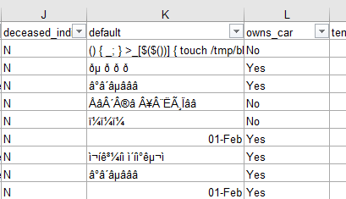
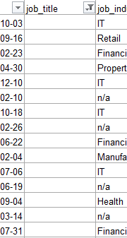
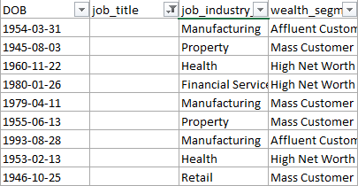
Data Exploration
Inconsistency in the data provided
After reviewing the data, I came to know that the attributes are missing of the data ( i.e., blanks ) in the records like job titles, brand of products purchased, and mismatching of data types.
And inconsistent values for the same attribute.

Slide 5

Model Development
Pre-defined record values, Modification of the attributes for better analysis
The inconsistency of the data can be optimized by providing the pre-defined data fields, so that the customer can select one of the respective category that matches him.
And instead of acquiring the date of birth attribute, consider taking the age. Similarly, consider the job titles, gender. So that the targeted customers can be found with ease and advertising can be promoted to that peer groups.

Slide 6

Interpretation
Interpreted Ideas
Considering the groups of most customers in some of the particular fields might help to expand the business at Sprocket Central Pty Ltd.
And analysing the most purchased products can help the Sprocket Central inventory maintenance easy and profitable.

Slide 7

Appendix
Contact info :
K. Bheema Linga Sai
Contact: 6300219562

